Slide 1

Database Systems: Design, Implementation, and Management
Chapter 3
The Relational Database Model

Slide 2
A Logical View of Data
Relational model
  View data logically rather than physically
Table
  Structural and data independence
  Resembles a file conceptually
Database Systems, 9th Edition

Slide 3
Tables and Their Characteristics
Logical view of relational database based on relation
  Relation thought of as a table
Table: two-dimensional structure composed of rows and columns
Database Systems, 9th Edition

Slide 4
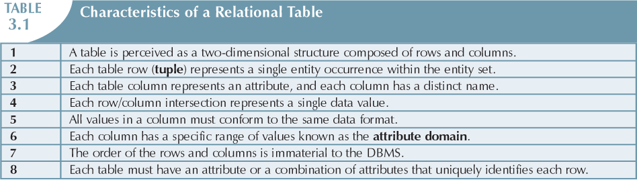
Exam!
Database Systems, 9th Edition

Slide 5
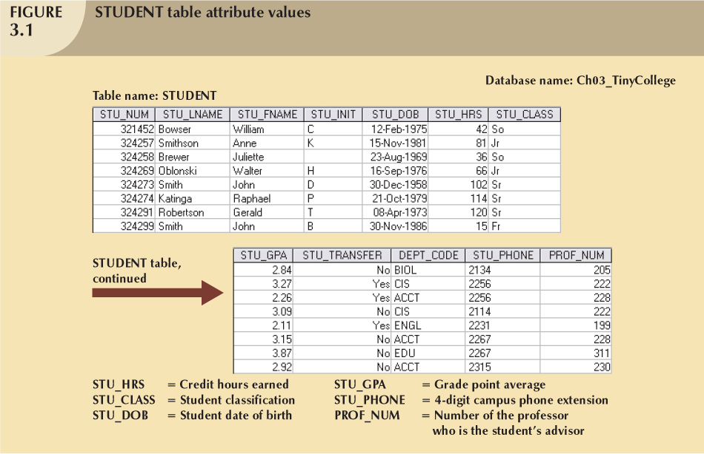
Database Systems, 9th Edition

Slide 6
Primary Keys
Each row in a table must be uniquely identifiable
Primary Key is one or more attributes that determine other attributes
Key’s role is based on determination
  If you know the value of attribute A, you can determine the value of attribute B
Database Systems, 9th Edition

Slide 7
Functional Dependency - Definition
A functional dependency occurs when one attribute in a relation uniquely determines another attribute. This can be written A -> B which would be the same as stating "B is functionally dependent upon A.“

Slide 8
FD Example
In a table listing employee characteristics including Social Security Number (SSN) and name, it can be said that name is functionally dependent upon SSN (SSN -> name) because an employee's name can be uniquely determined from their SSN.
However, the reverse statement (name -> SSN) is not true because more than one employee can have the same name but different SSNs.

Slide 9
Keys (continued)
PRIMARY key
  One or more attributes which determine the value of each of the other attributes within the row and which is unique amongst the set of like attributes in the table
Composite key
  A key which is formed from a combination of attributes
Key attribute
  Any attribute that is part of a composite key
Superkey
  Any key that uniquely identifies each row. Normally, too complex (with too many attributes) to be used as a Primary Key
Candidate key
  A candidate for selection as a Primary Key.
Database Systems, 9th Edition

Slide 10
Keys (continued)
Nulls
  An attribute for which an actual value has not been entered:
    No data entry
    Not permitted in primary key
    Should be avoided in other attributes
    Can represent
      An unknown attribute value
      A known, but missing, attribute value
      A “not applicable” condition
Database Systems, 9th Edition

Slide 11
Keys (continued)
Nulls:
  Can create problems when functions such as COUNT, AVERAGE, and SUM are used
  Can create logical problems when relational tables are linked
Database Systems, 9th Edition

Slide 12
Keys (continued)
Controlled redundancy
Same Data may be stored in more than one place to provide links between entities (tables)
  Makes the relational database work for 1:M relationships (see Fig 3.2 – next slide)
  Tables within the database share common attributes
    Enables tables to be linked together
  Redundancy exists only when there is unnecessary duplication of attribute values
Database Systems, 9th Edition

Slide 13
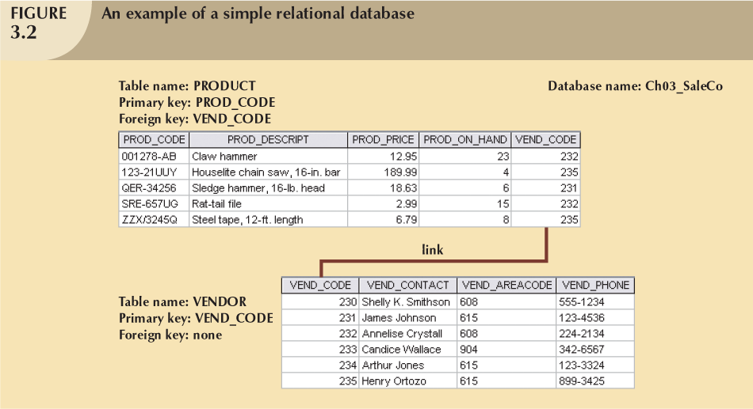
One to Many Relationship between Vendor and Product:
OneVENDOR may supply many PRODUCTS
(as for products 2 & 5 in product table – VEND_CODE 235)
Database Systems, 9th Edition

Slide 14
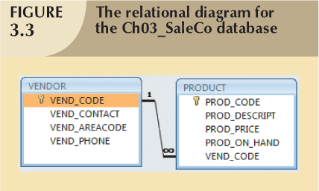
As would be shown in an MS Access or MS SQL database diagram
Database Systems, 9th Edition

Slide 15
Keys (continued)
Foreign key (FK)
  An attribute whose values match primary key values in the related table (e.g. Vendor Code in product table)
Secondary key
  Key used strictly for data retrieval purposes – allows for ordering on a non primary key attribute.
Database Systems, 9th Edition

Slide 16
Integrity
Entity Integrity
  All primary Key values are unique and no part
  may be null
Referential integrity
  FK contains a value that refers to an existing valid tuple (row) in another relation
EXAM

Slide 17
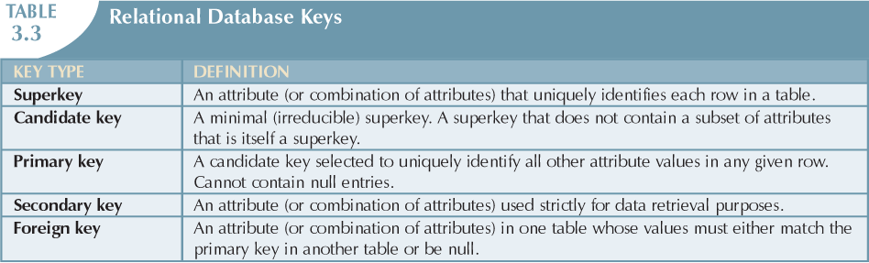
Different sets of attributes which are able to identify any row in the
table are known as superkeys.
(Product Description+LocationCode+color)
A minimal super key is termed as candidate key. i.e. among set of super
keys one with minimum number of attributes. If color was always red:
(Description+LocationCode)
Primary key could be any key which is able to identify
a specific row in database in a unique manner. (e.g. Product No.)
Database Systems, 9th Edition

Slide 18
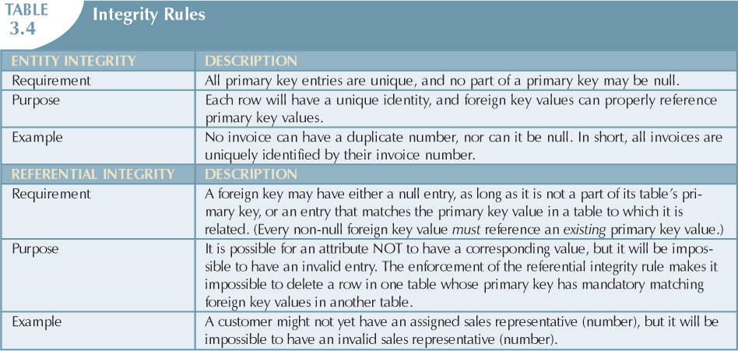
Need to know this in order to do the up coming class exercise
Database Systems, 9th Edition

Slide 19
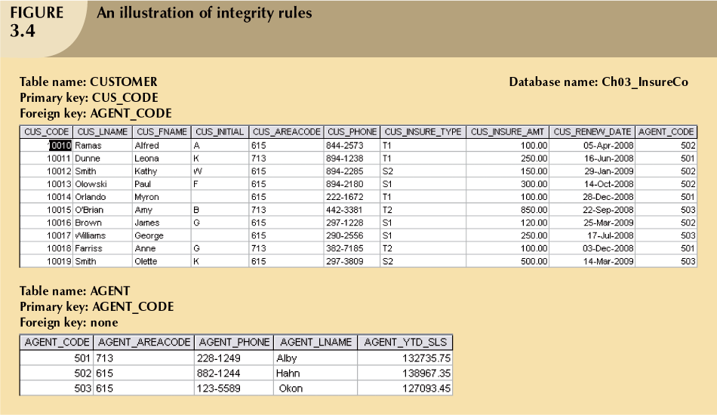
Agent Code 501 cannot be removed from the Agent Table as it exists as a
Foreign key in the Customer table
These two tables together manifest both Entity Integrity as well as Referential Integrity – Let’s consider why…
Database Systems, 9th Edition

Slide 20
Integrity Rules
Many RDBMs enforce integrity rules automatically
Safer to ensure application design conforms to entity and referential integrity rules
Database Systems, 9th Edition

Slide 21
Relational Set Operators
Relational algebra
  Defines theoretical way of manipulating table contents using relational operators
  Use of relational algebra operators on existing relations produces new relations
    UNION INTERSECT
    DIFFERENCE PRODUCT
    SELECT PROJECT JOIN DIVIDE
Database Systems, 9th Edition

Slide 22
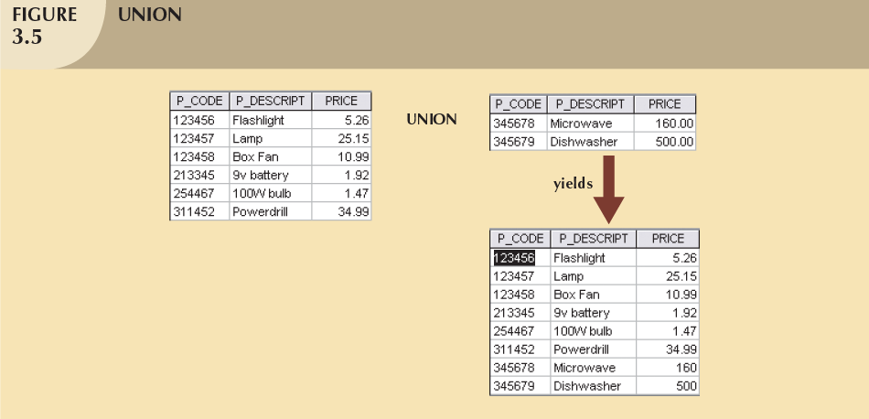
Union – Combines or Adds 2 relations or tables
Database Systems, 9th Edition

Slide 23
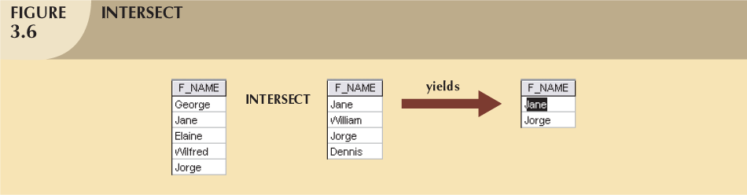
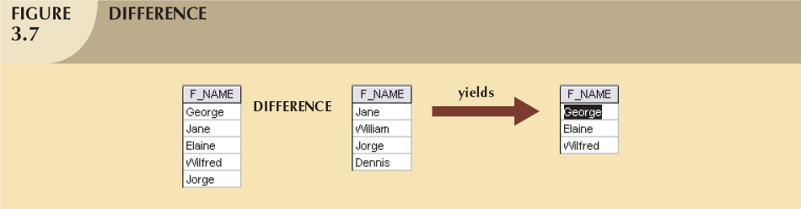
INTERSECT – Selects Matching Values in same column from both tables
DIFFERENCE – Selects only items which do not intersect
Database Systems, 9th Edition

Slide 24
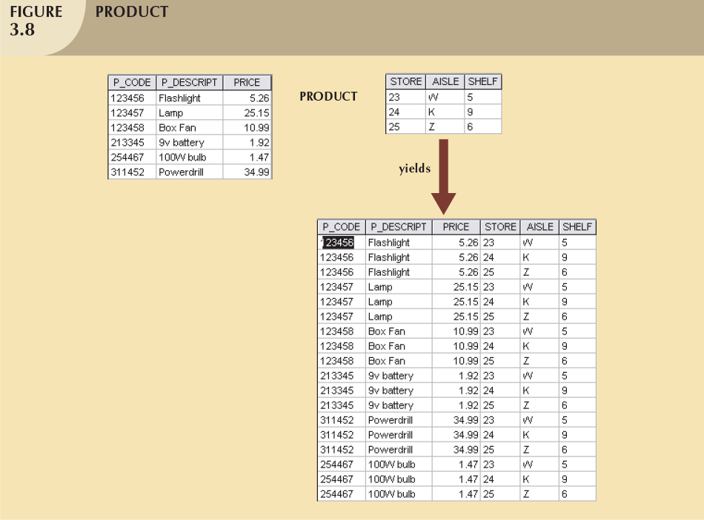
PRODUCT – yields rows which are a combination – the columns from
each row in table B are added to the columns of each row in table A
Database Systems, 9th Edition

Slide 25
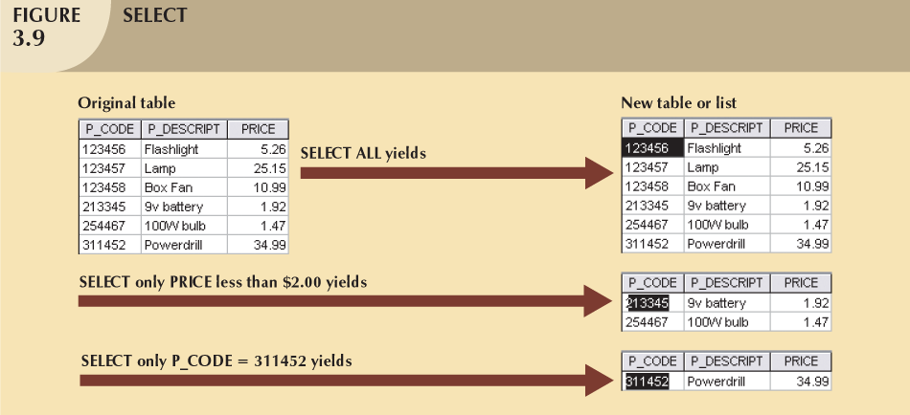
SELECT – Restrict the output set
Database Systems, 9th Edition

Slide 26
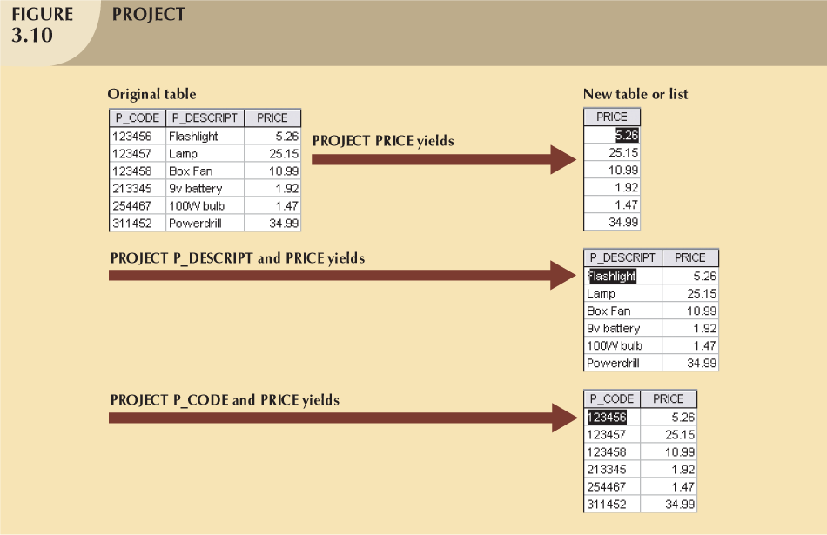
PROJECT – Restrict the Output Columns
Database Systems, 9th Edition

Slide 27
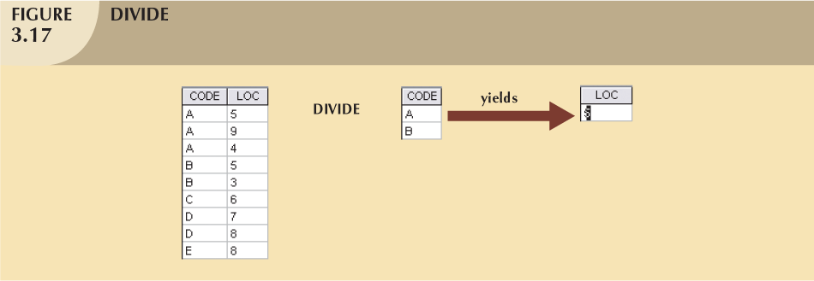
DIVIDE – 2 column table (A) divided by 1 column table (B) with common column
Produces 2nd column from table A where there is a common value in Table A for the
Columns in Table B . More explanation on page 73
Database Systems, 9th Edition

Slide 28
Relational Set Operators (continued)
Natural Join
  Links tables by selecting rows with common values in common attribute(s)
Equijoin
  Links tables on the basis of an equality condition that compares specified columns
Theta join
  Any other comparison operator is used
Outer join
  Matched pairs retained and any unmatched values in other table left null
Database Systems, 9th Edition

Slide 29
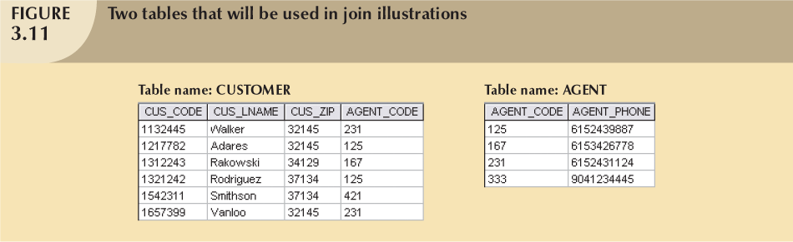
Joins: Natural , Equi, Theta, Outer
Note:
No 421 in agent table
No 333 in Customer table
Database Systems, 9th Edition
Assume no Referential Integrity rules in place

Slide 30
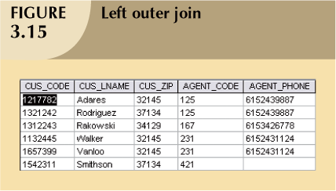
LEFT OUTER JOIN: Adds new columns from second table
to the first table with matching on common column
(Agent Code, in this example) to produce a third table
Database Systems, 9th Edition

Slide 31
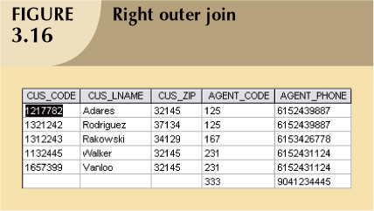
RIGHT OUTER JOIN: Adds new columns from first table to the second table
with matching on common column (Agent Code, in this example)
to produce a third table
Database Systems, 9th Edition

Slide 32
More on Joins to come when we use SQL in the second half of this course

Slide 33
The Database Data Dictionary and System Catalog
Data dictionary and System catalog contain:
    Metadata
  Detailed accounting of all tables found within the database
  Contains (at least) all the attribute names and characteristics for each table in the system
  Detailed system data dictionary that describes all objects within the database
Database Systems, 9th Edition

Slide 34
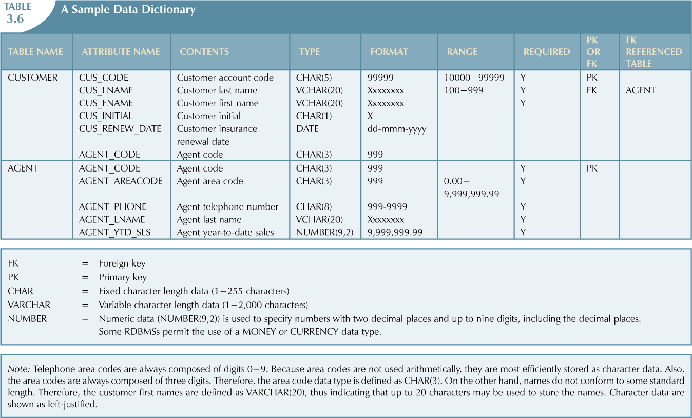
Database Systems, 9th Edition

Slide 35
Relationships within the Relational Database
1:M relationship
  Relational modeling ideal
  Should be the norm in any relational database design
1:1 relationship
  Should be rare in any relational database design
Database Systems, 9th Edition

Slide 36
Relationships within the Relational Database (continued)
M:N relationships
  Cannot be implemented as such in the relational model
  M:N relationships can be changed into two 1:M relationships
Database Systems, 9th Edition

Slide 37
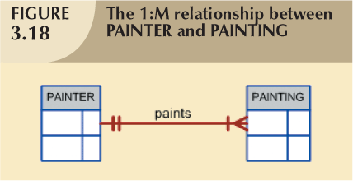
The 1:M Relationship
Relational database norm
Found in any database environment
Database Systems, 9th Edition

Slide 38
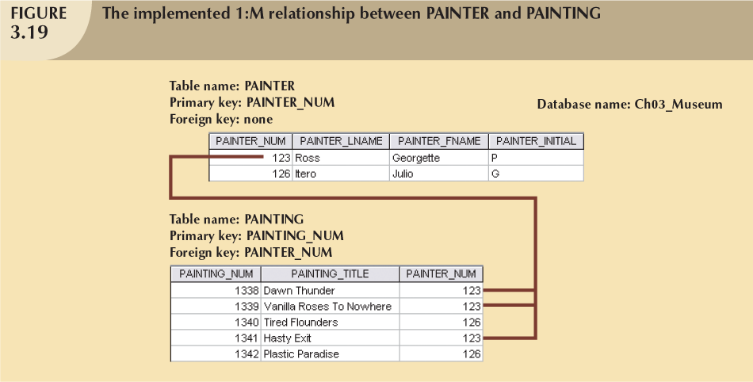
Database Systems, 9th Edition

Slide 39
The 1:1 Relationship
One entity related to only one other entity, and vice versa
Sometimes means that entity components were not defined properly
Could indicate that two entities actually belong in the same table
Database Systems, 9th Edition

Slide 40
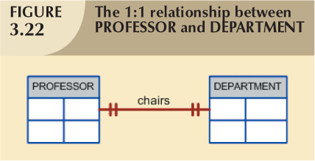
Exam
This would be allowed, if every professor chaired one department. It would mean that there are as many departments as there are professors – unusual to have this, since we would normally have more professors that departments.
If it were the case, this one: one relationship would be implemented by having a Professor_id attribute in the Department Entity and Department_id attribute in the Professor entity. Both of these FKs would have a NON NULL and UNIQUE FK constraints. – HOW DOES THIS ACHIEVE OUR GOAL?
Database Systems, 9th Edition

Slide 41
The M:N Relationship
Implemented by breaking it up to produce a set of 1:M relationships
Avoid problems inherent to M:N relationship by creating a composite entity
  Includes as foreign keys the primary keys of tables to be linked
Database Systems, 9th Edition

Slide 42
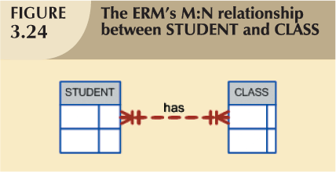
Students can attend many classes
Database Systems, 9th Edition

Slide 43
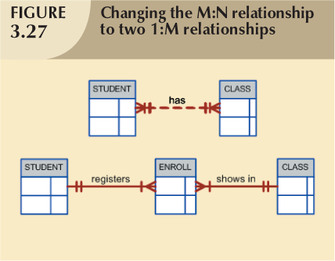
Database Systems, 9th Edition

Slide 44
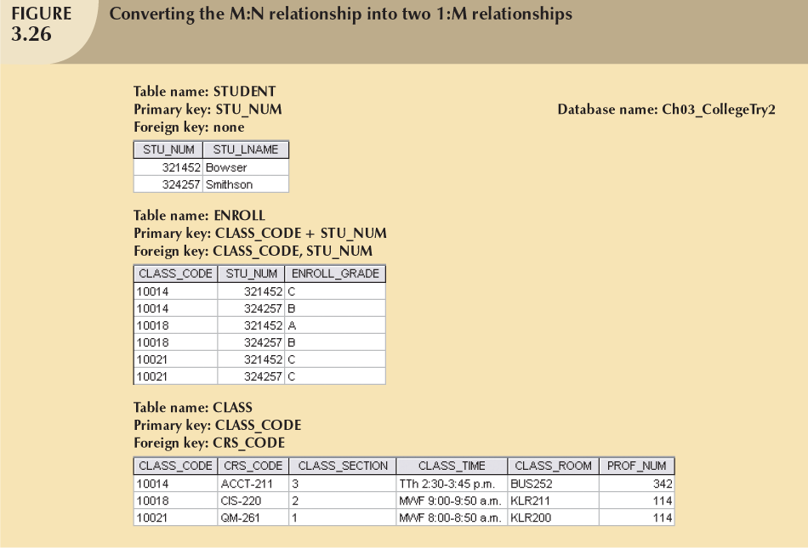
Bowser (321452) participates in 3 enrollments identified by a composite key. All entries for Bowser can be linked to the Class table and the Student table where Bowser is associated by the class code and student number, respectively.

Slide 45
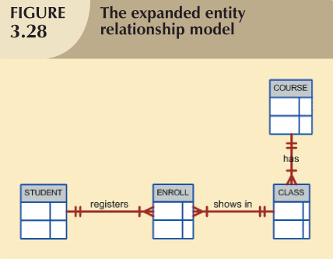
Database Systems, 9th Edition

Slide 46
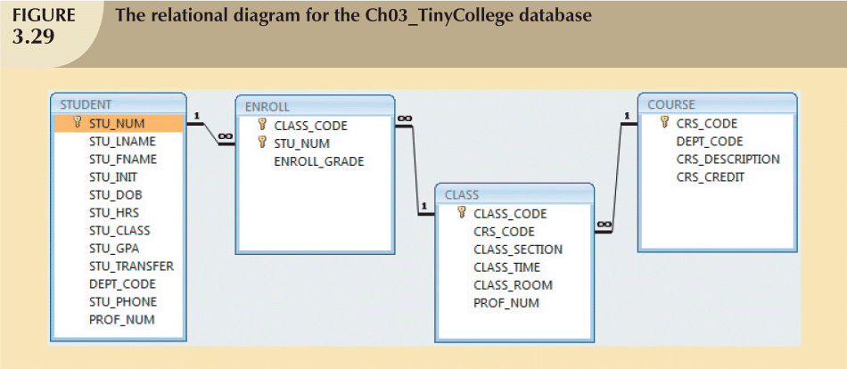
Database Systems, 9th Edition

Slide 47
Relational Schemas
These are is written in this manner:
PROJECT (PROJ_NUM, PROJ_NAME)
ENROLL (CLASS_CODE, STU_NUM, ENROLL_GRADE)
ENROLL is the name of the entity
CLASS_CODE+STU_NUM is the Composite Primary key (underlined)
ENROLL_GRADE is a non key attribute

Slide 48
Data Redundancy (Reminder)
Foreign keys hold values which appear as Primary Keys in the parent table (the one side). This is not the same as regular Data Redundancy. These values are required in order to relate one table to another.
Since you cannot change a foreign key value to a value that does not corresponding to an existing Primary key value, the redundancy is managed and controlled.
Database Systems, 9th Edition
EXAM

Slide 49
Indexes
Orderly arrangement to logically access rows in a table
Index key
  Index’s reference point
  Points to data location identified by the key
Unique index
  Index in which the index key can have only one pointer value (row) associated with it
Each index is associated with only one table
Database Systems, 9th Edition

Slide 50
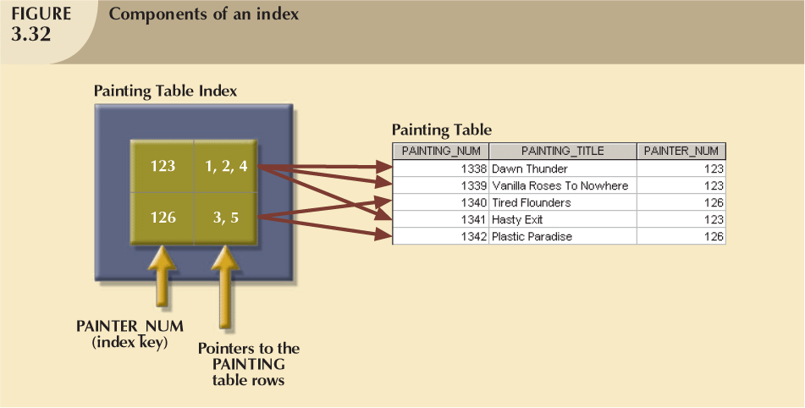
Database Systems, 9th Edition

Slide 51
Codd’s Relational Database Rules
In 1985, Codd published a list of 12 rules to define a relational database system.
(See Table 3.8)
  Products marketed as “relational” that did not meet minimum relational standards
Even dominant database vendors do not fully support all 12 rules
Database Systems, 9th Edition

Slide 52
Summary
Tables are basic building blocks of a relational database
Keys are central to the use of relational tables
Keys define functional dependencies
  Superkey
  Candidate key
  Primary key
  Secondary key
  Foreign key
Database Systems, 9th Edition

Slide 53
Summary (continued)
Each table row must have a primary key that uniquely identifies all attributes
Tables linked by common attributes
The relational model supports relational algebra functions
  SELECT, PROJECT, JOIN, INTERSECT UNION, DIFFERENCE, PRODUCT, DIVIDE
Good design begins by identifying entities, attributes, and relationships
  1:1, 1:M, M:N

Slide 54
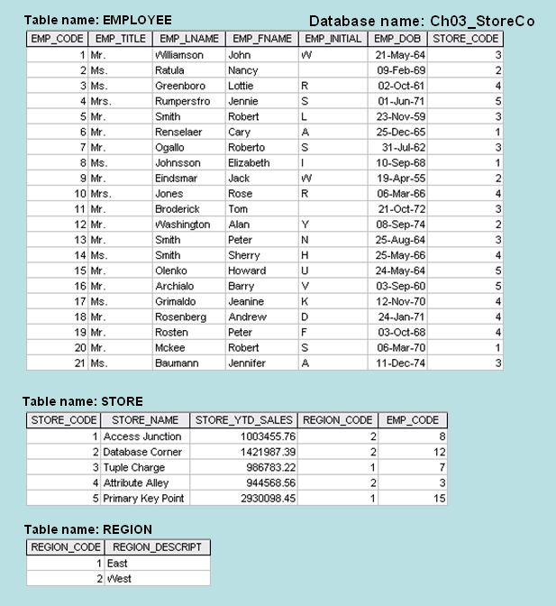
Class Exercise (Probs 1-3 Ch 3 Page 98)
See Page
99 for
bigger diagram
Note: The EMP_CODE in the STORE table refers to the EMP_CODE of the Store’s Manager
For each table, identify the primary key and the foreign key(s). If a table does not have a foreign key, write None in the space provided.
2. Do the tables exhibit entity integrity? Answer yes or no and then explain your answer.
Do the tables exhibit referential integrity? Answer yes or no and then explain your answer. Write NA (Not Applicable) if the table does not have a foreign key.

